Slide 1
Introduction & 8 Important Problems in Modern Operating Systems
Yubin Xia
Institute of Parallel and Distributed Systems (IPADS)
Shanghai Jiao Tong University
http://ipads.se.sjtu.edu.cn/Yubin_xia

Slide 2
Outline
Why Choose This Course?
8 important problems of OS
Course information

Slide 3
Recall
What is OS from a programmer’s perspective?
A set of API, aka, system calls
E.g., int 0x80
What are differences from other API?
The system calls are usually hardware related
E.g., fork, FILE ops, socket, select/epoll
Who invokes the system calls?
Application itself, libraries (e.g., glibc)
Application through the libraries

Slide 4
Software Stack
Architecture
Functionality and Appearance of a computer system but not implementation details
Level of Abstraction = Implementation layer
ISA, ABI, API
Application
Programs
Libraries
ABI
Operating System
Drivers
Memory
Manager
Scheduler
API
ISA
Execution Hardware
Memory
Translation
System Interconnect (Bus)
Controllers
Controllers
IO Devices,
Networking
Main Memory

Slide 5
Architecture, Implementation Layers
Implementation Layer : ISA
Instruction Set Architecture
Divides hardware and software
Concept of ISA originates from IBM 360
IBM System/360 Model (20, 40, 30, 50, 60, 62, 70, 92, 44, 57, 65, 67, 75, 91, 25, 85, 95, 195, 22) : 1964~1971
Various prices, processing power, processing unit, devices
But guarantee a software compatibility
User ISA and System ISA

Slide 6
Implement the ISA
Machine from the perspective of a system
ISA provides interface between system and machine
Application Software
Application
Programs
Libraries
Operating System
Operating System
Drivers
Memory
Manager
Scheduler
System ISA
User ISA
Execution Hardware
ISA
Memory
Translation
Machine
System Interconnect (Bus)
Controllers
Controllers
IO Devices,
Networking
Main Memory
Question: ISA Emulation?

Slide 7
Architecture, Implementation Layers
Implementation Layer : ABI
Application Binary Interface
Provides a program with access to the hardware resource and services available in a system
Consists of User ISA and System Call Interfaces

Slide 8
Implement the ABI
Machine from the perspective of a process
ABI provides interface between process and machine
Application Software
Application
Programs
Libraries
System calls
Operating System
Drivers
Memory
Manager
Scheduler
User ISA
Execution Hardware
ABI
Memory
Translation
Machine
System Interconnect (Bus)
Controllers
Controllers
IO Devices,
Networking
Main Memory
Question: Which software
does ABI Emulation?

Slide 9
Architecture, Implementation Layers
Implementation Layer : API
Application Programming Interface
Key element is Standard Library ( or Libraries )
Typically defined at the source code level of High Level Language
clib in Unix environment : supports the UNIX/C programming language

Slide 10
Why Study OS?
Operating system is a maturing field
Hard to get people to switch operating systems
Then why?
Many things are OS issues
High-performance
Resource consumption
Battery life, radio spectrum
Security needs a solid foundation
New “smart” devices need new OSes
Q: What applications are highly OS-related, which are not?

Slide 11
Why Study OS?
OS is the core of the broad “systems area”
Lots of systems companies
Microsoft, Google, IBM, EMC, CISCO, VMware
What’s Google’s core?
Google Cluster, GFS, MapReduce, BigTable
Good OS knowledge is a necessity to get you good offers/promotions
at such companies and top universities

Slide 12
Real Machine VS. Abstraction Machine
Carnegie Mellon
Many courses emphasize abstraction
Abstract data types
Asymptotic analysis
These abstractions have limits
Especially in the presence of bugs
Need to understand details of underlying implementations

Slide 13
Useful outcomes from taking this course
Become more efficient programmers
Able to find and eliminate bugs efficiently
Able to understand and tune for program performance
Understand design and implementation of real complex systems
Try to build one on your own (like a Turing-award level OS)

Slide 14
Is “simple” really simple?
A simple program?
How does it get executed?
#include <stdio.h>
int main() {
printf(“hello world\n”);
return 0;
}
How does it got translated to machine code?
How does the program get executed in detail?
Link, load, execute, finish?
Notes:
简约不简单

Slide 15
Course Perspective
Carnegie Mellon
Our Course is Programmer-Centric
Purpose is to show that by knowing more about the underlying system, one can be more effective as a programmer
Enable you to
Write programs that are more reliable and efficient
Incorporate features that require hooks into OS
E.g., concurrency, signal handlers
Build an operating system!
Cover material in this course that you won’t see elsewhere
Not just a course for dedicated hackers

Slide 16
Outline
Why we study OS?
8 problems of OS
Course information

Slide 17
8 Important Problems in Operating systems

Slide 18
8 Important Problems (Not a Rank)
Scale Up
Security & Privacy
Energy Efficiency
Mobility
Write Correct (Parallel) Code
Scale Out
Non-Volatile Storage
Virtualization

Slide 19
#1: Scale up (or Performance Scalability)

Slide 20




Multicore Evolution
Multicore is commercially prevalent recently
Eight cores and Twelve cores on a chip are common
Hundreds of cores on a single chip will appear in near feature
Challenge#1: make software performance follow Moore’s Law
1X
4X
8X
64X
Notes:
The multicore platform is prevalent recently. For example, Quad-cores and eight cores on a chip becomes very common. It was predicted that tens and hundreds of cores on a single chip will appear in the near future.
Hence, data-parallel applications could be the potential ideal consumer to harness the power of multicore platform.

Slide 21
Why Operating System Matters?
Terms of operating system here
Broadly defined, including hypervisor, operating systems, runtime environments
Operating systems manage and hide resources from applications
Hide tedious and complex low-level details
Provide execution environments to apps
Operating systems determines app perf. in many cases
Many apps spend a large fraction of time in system software

Slide 22
Operating System Meets Multicore
(Operating) systems 20 years ago
Enjoys the free lunch provided by hardware (Moore’s Law)
Recall the Andy-Bill’s Law
Multicore: ending the free lunch!
Software must evolve with hardware changes
OS: a vital role to bridge the gap between apps and hardware
Need to evolve itself with multicore
Need to evolve for apps with multicore

Slide 23
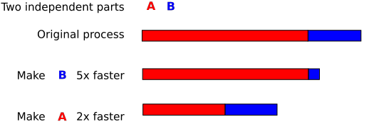
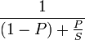
What is scalability?
Application does N times as much work on N cores as it could on 1 core
Scalability may be limited by Amdahl's Law:
Locks, shared data structures, ... Shared hardware (DRAM, NIC, ...)

Slide 24
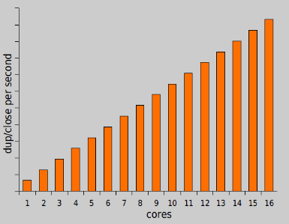
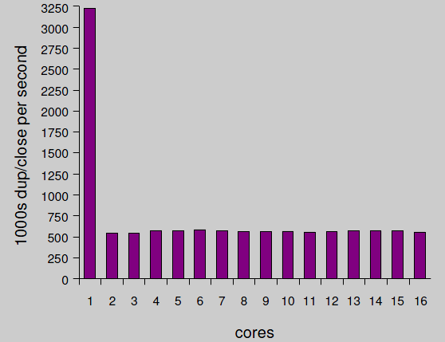
Motivating example: file descriptors
Ideal FD performance graph
Actual FD performance

Slide 25
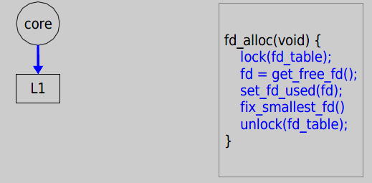
Why throughput drops?
Load fd_table data from L1 in 3 cycles.

Slide 26
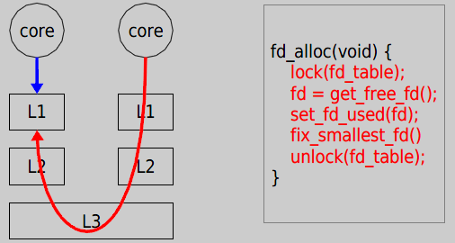
Why throughput drops?
Now it takes 121 cycles!

Slide 27
Off-the-shelf 48-core server
6 core x 8 chip AMD

Slide 28
Scale Up OS
Better abstraction to user applications
Eliminating non-scalable synchronization
Minimize sharing of common data structures
You will fill this..

Slide 29
Issue#2: Security & Privacy

Slide 30


Security
From Wikipedia:
Security is the degree of resistance to, or protection from, harm
Why Operating System matters?
Operating system (including hypervisors) lies in the lowest levels in a computer
How could you protect your application & data without properly protect your OS
Notes:
Buffer overflow: if you control myOS, you can nearly do anything?

Slide 31
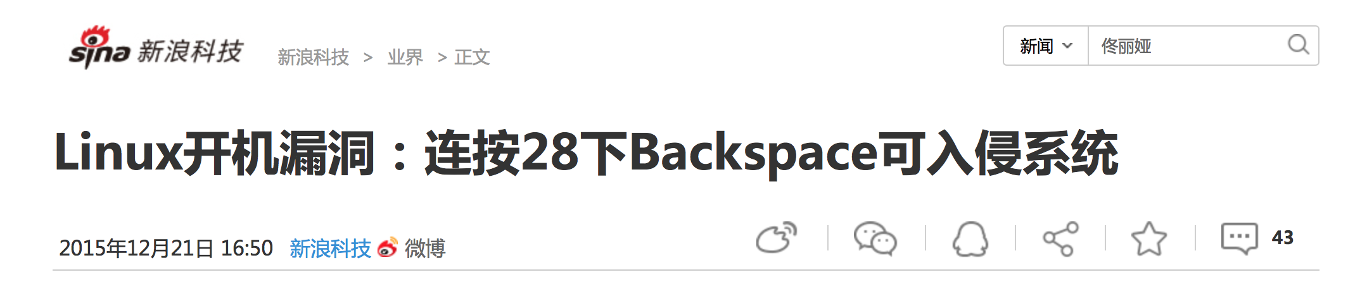
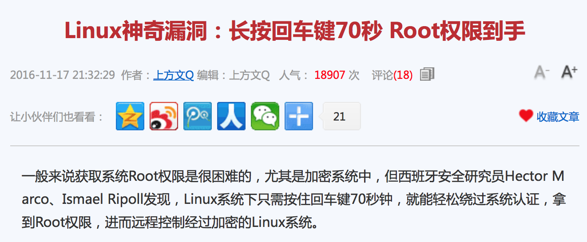
CVE-2015-8370
CVE-2016-4484
Notes:
瓦伦西亚科技大学网络安全小组研究人员Hector Marco与 Ismael Ripoll在Grub 2中，发现存在一项整数下溢(integer underflow)漏洞，编号CVE-2015-8370。通过该漏洞成功入侵的黑客可进入GRUB的Rescue Shell，进而提升权限、复制磁盘信息、安装RootKit、或是摧毁包括GRUB在内的任何资料，即使磁盘加密也可能遭到覆写，导致系统无法工作。
研究人员发现该漏洞的攻击方法相当简单：只需在GRUB要求输入用户名时，连续按28次倒退键，就可进入Rescue Shell。IT管理员只需按照此方法操作，若看到系统重启，或是进入救援模式，即可判断自己系统有此漏洞。
这个问题来自Linux标准磁盘加密程序Cryptsetup的一个漏洞(CVE-2016-4484)，它处理密码输入错误的时候，会允许用户多次重试输入，直到错误超过93次，程序就会给用户一个带Root权限的shell(busybox)。也就是说，如果你重复93次输错密码，或者持续按回车键大概70秒，就能够获得root initramfs (initial RAM filesystem) shell。

Slide 32
Example: The do_brk() Bug
Asmlinkage unsigned long sys_brk(unsigned long brk) {
…
/* OK, looks good – let it rip. */
- if (do_mmap(NULL, oldbrk, newbrk-oldbrk,
- PROT_READ|PROT_WRITE|PROT_EXEC,
- MAP_FIXED|MAP_PRIVATE, 0) != oldbrk)
+ if (do_brk(oldbrk, newbrk-oldbrk) != oldbrk)
goto out;
Purpose of do_brk() was to speed up anonymous mmaps from sys_brk()
do_mmap() checked things properly, do_brk() removed almost all checking

Slide 33
The do_brk() Fix
if (!len)
return addr;
+ if ((addr + len)) > TASK_SIZE || (addr + len) < addr)
+ return –EINVAL;
+
The TASK_SIZE is typically set to 0xc0000000, the start of kernel memory

Slide 34
Issue#3: Power Efficiency

Slide 35

Power Efficiency
Greener World, Better Life!
Again, why it has to do with OS?
OS control every computer and many devices!
Thus determines the power used by each computer

Slide 36
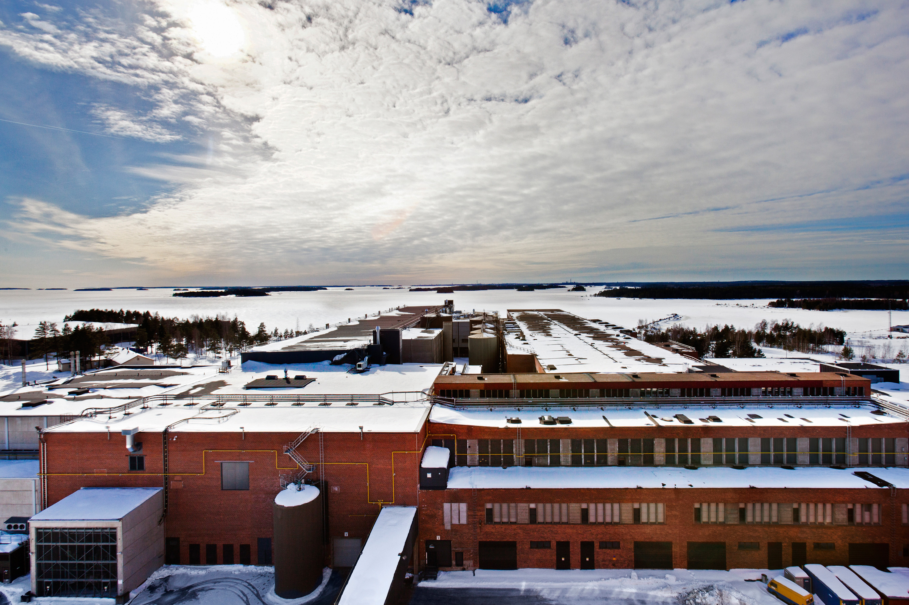
Google Datacenter: Finland

Slide 37
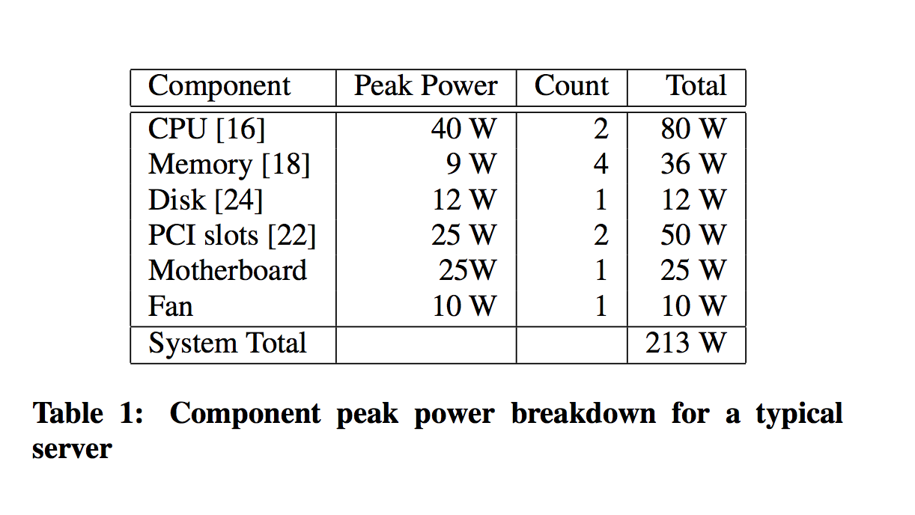
Power Breakdown in Server

Slide 38
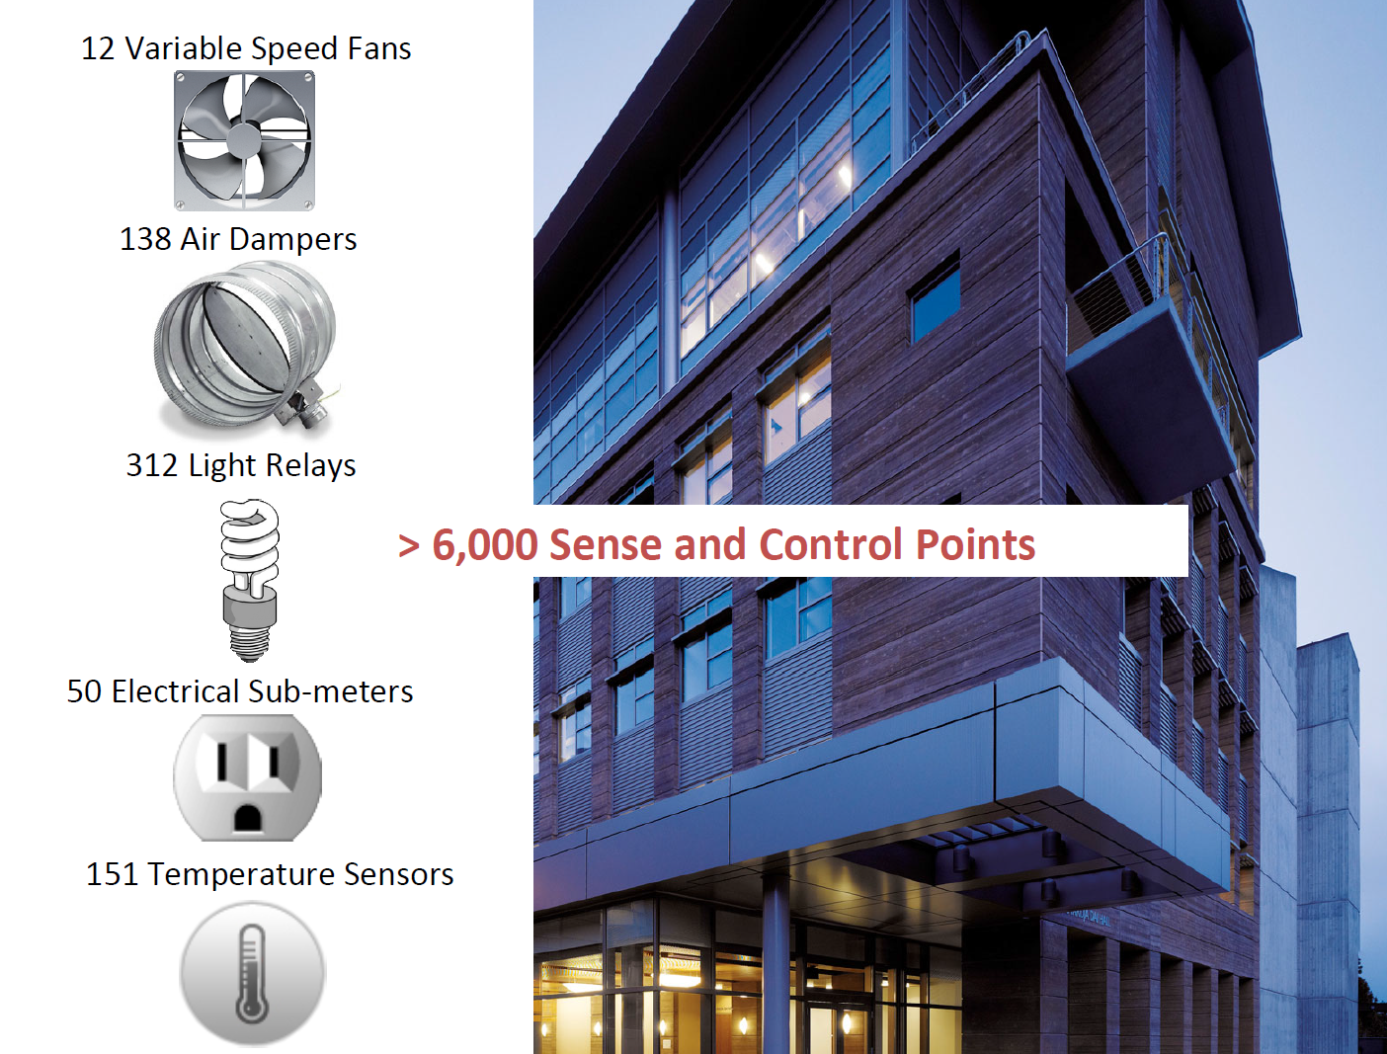

Slide 39
Why Operating System Matters?
Dynamic voltage and frequency scaling
Adjust the frequency of CPU according to workload
Power off devices to save power
Like disk, LCD, or even memory
Problem: energy consumption doesn’t scale with workloads
Static power, leakage power
New!: Near Threshold Voltage

Slide 40
Issue#4: Mobility

Slide 41
Smartphone OS
Symbian
Windows Mobile
RIM Blackberry OS
Apple iOS
Google Android
Palm WebOS
Windows Phone 7

Slide 42
Android Software Stack
Linux kernel
Libraries
Android run time
core libraries
Dalvik virtual machine
application layer
application protocol

Slide 43
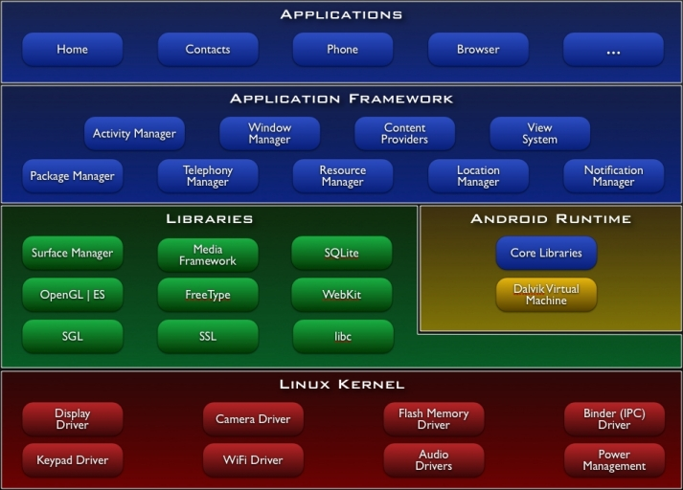
Android Architecture

Slide 44
What’s Unique for Mobile OS?
Energy Efficiency
Richer User Experience
But more limited resources
Security
More user data put into mobile OSes

Slide 45
Issue#5: Write Correct Parallel Code

Slide 46
Writing concurrent program is really HARD!
Concurrent programs are prone to concurrency bugs
Concurrency bugs have notorious characteristics
Non-deterministic
Hard to test and diagnose
But in multi-core era, we need to write concurrent program to harness the power of multi-core

Slide 47
Quote from Dijkstra
I am convinced more than ever that this type of work is very difficult, and that every effort to do it with other than the best people is doomed to either failure or moderate success at enormous cost.
Edsger Dijkstra
The Structure of the “THE” –Multiprogramming System
1968

Slide 48
Easiest One
Thread 1
Thread 2
if (thd->proc_info) {
…
fputs(thd->proc_info, …)
…
}
thd->proc_info = NULL;
MySQL ha_innodb.hpp

Slide 49
Approaches to addressing the problem
Concurrency bug detection
Race detection
Atomicity violation detection
Deadlock bug detection
Concurrent program testing
Exhaustive testing
Different coverage criteria proposed
Concurrent programming language/model design
Transactional memory

Slide 50
What OS can do?
Reduce sources of non-determinism
Tolerate application bugs
Faithfully capture concurrency bugs for reproducing
Provide better programming interfaces to ease programming
Operating transactions

Slide 51
Issue#6: Scale Out (use distributed systems)

Slide 52
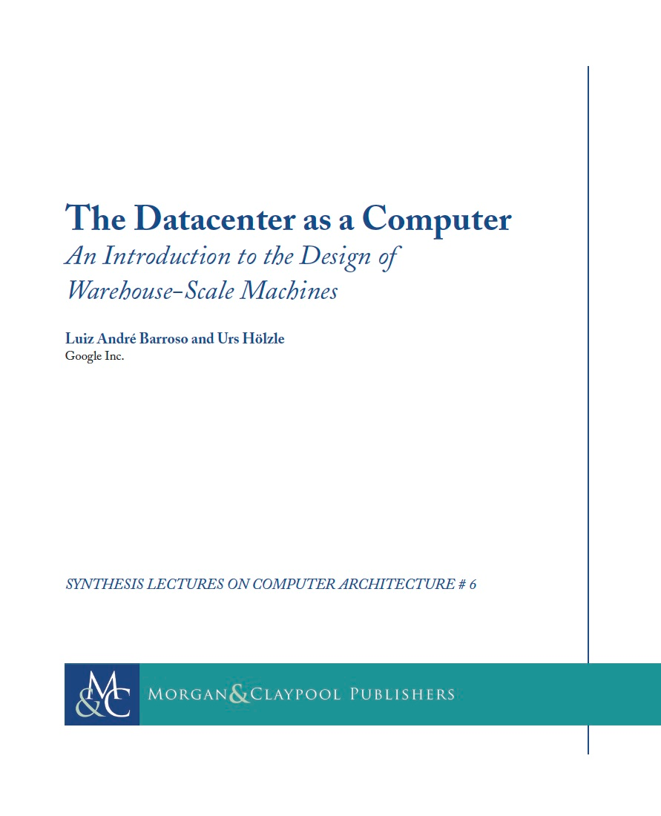

Slide 53
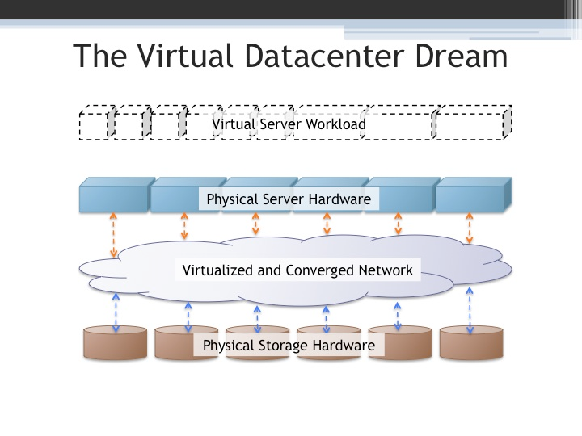

Slide 54

What are distributed systems?
Multiple
hosts
A network cloud
Hosts cooperate to provide a unified service
Examples?
Notes:
Multiple computers
Network interconnection (LAN or WAN).
Cooperative to provide some service
Example: Akamai CDN, network file systems, distributed database, DNS
Counterexample: a single shared UNIX machine

Slide 55
Why distributed systems? for ease-of-use
Handle geographic separation
Provide users (or applications) with location transparency:
Web: access information with a few “clicks”
Network file system: access files on remote servers as
if they are on a local disk, share files among multiple computers

Slide 56
Why distributed systems? for availability
Build a reliable system out of unreliable parts
Hardware can fail: power outage, disk failures, memory corruption, network switch failures…
Software can fail: bugs, mis-configuration, upgrade …
To achieve 99.999% availability, replicate data/computation on many hosts with automatic failover

Slide 57
Why distributed systems? for scalable capacity
Aggregate resources of many computers
CPU: Dryad, MapReduce, Grid computing
Bandwidth: Akamai CDN, BitTorrent
Disk: Frangipani, Google file system

Slide 58
Why distributed systems? for modular functionality
Only need to build a service to accomplish a single task well.
Authentication server
Backup server

Slide 59
Challenges
System design
What is the right interface or abstraction?
How to partition functions for scalability?
Consistency
How to share data consistently among multiple readers/writers?
Fault Tolerance
How to keep system available despite node or network failures?

Slide 60
Challenges (continued)
Different deployment scenarios
Clusters
Wide area distribution
Sensor networks
Security
How to authenticate clients or servers?
How to defend against or audit misbehaving servers?
Implementation
How to maximize concurrency?
What’s the bottleneck?
How to reduce load on the bottleneck resource?
Notes:
Prompt students to answer questions for a mini-quiz
Memory load 30ns
Disk seek >5ms (Solid state disk 0.1-0.3ms)
Disk throughput 40M
LAN throughput
LAN latency
WAN throughput
WAN latency

Slide 61
A word of warning
A distributed system is a system in which I can’t do my work because some computer that I’ve never even heard of has failed.”
-- Leslie Lamport

Slide 62
Issue#7: Non-Volatile Storage

Slide 63
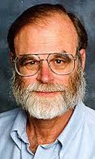
Tape is Dead Disk is Tape Flash is Disk RAM Locality is King
Jim Gray
Microsoft
December 2006
In memory of Jim Gray
Notes:
lost at sea January 28, 2007

Slide 64
Tape Is Dead Disk is Tape
1TB disks are available
10+ TB disks are predicted in 5 years
Unit disk cost: ~$400 → ~$80
But: ~ 5..15 hours to read (sequential)
~15..150 days to read (random)
Need to treat most of disk as Cold-storage archive

Slide 65
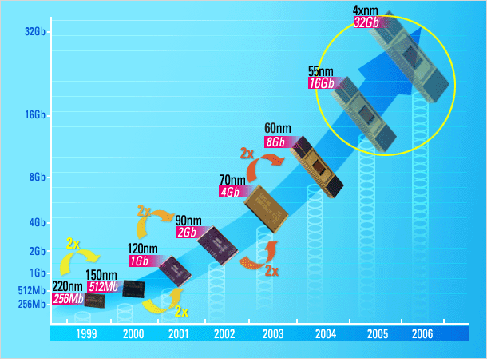

FLASH Storage?
1995 16 Mb NAND flash chips 2005 16 Gb NAND flash Doubled each year since 1995
Market driven by Phones, Cameras, iPod,… Low entry-cost, ~$30/chip → ~$3/chip
2012 1 Tb NAND flash == 128 GB chip == 1TB or 2TB “disk” for ~$400 or 128GB disk for $40 or 32GB disk for $5
Samsung prediction

Slide 66
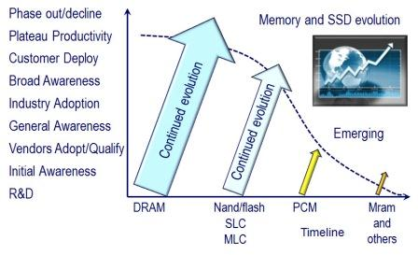
Storage Hiereary

Slide 67
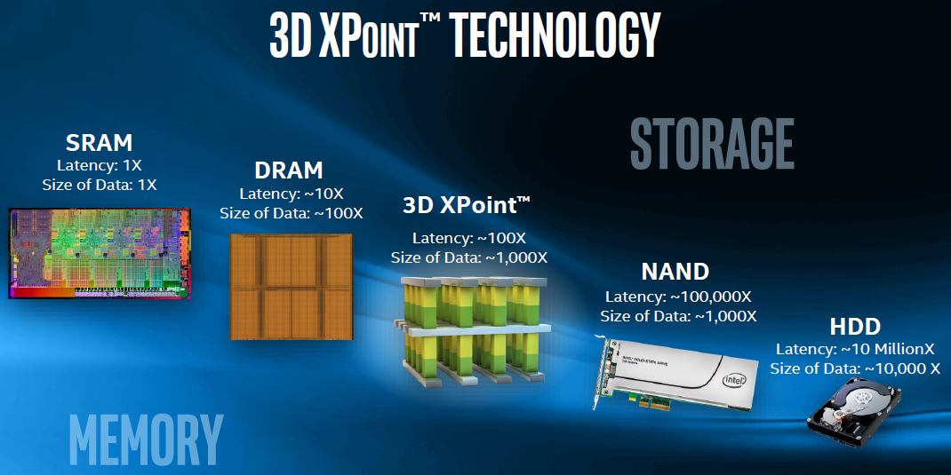
New Storage Keeps Coming

Slide 68
What can OS do?
Needs to adapt to the new storage model
Non-volatility changes the way operating system manage resources
Like crash recovery
Recall fsck
Better I/O performance

Slide 69
Issue#8: Virtualization

Slide 70
“Any problem in computer science can be solved with another level of indirection.”
David Wheeler in Butler Lampson’s 1992 ACM Turing Award speech.

Slide 71
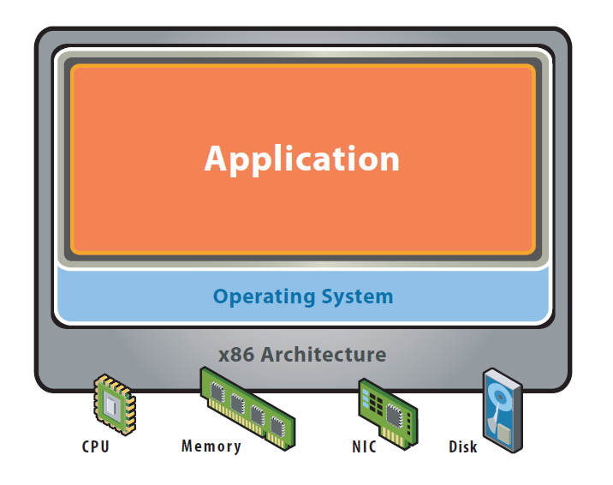
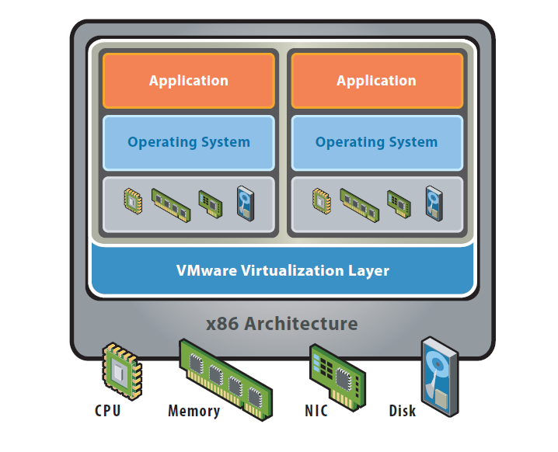
Concept of Virtualization
“Virtualization” refers to the creation of a virtual machine
A virtual machine is a software implementation of a machine (i.e. a computer) that executes programs like a physical machine
Before Virtualization
After Virtualization
* “Virtualization in education”, IBM, 2007
figures from: VMware white paper, virtualization overview
Notes:
Virtualization for complexity & Heterogeneity, sharing (making exclusive hardware sharable)
What is a difference between “platform virtualization” and others?
- it virtualizes ISA (CPU) such that OS can decouples from CPU.

Slide 72
Why Virtualization ?
Decoupling the operating systems from physical hardware supports
Maximum resource utilization
Multiple OS environments can co-exist on the same computer, in strong isolation from each other
Server consolidation
Fault tolerance
Fault and migrate
Portability
Can use any OS
Manageability
Easy to maintain
Notes:
Maximum resource utilization –
Server consolidation is an approach to the efficient usage of computer server resources in order to reduce the total number of servers or server locations that an organization requires. The practice developed in response to the problem of server sprawl, a situation in which multiple, under-utilized servers take up more space and consume more resources than can be justified by their workload
Multiple virtual machines
Portability
- the virtual machine can provide an instruction set architecture (ISA) that is somewhat different from that of the real machine

Slide 73
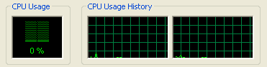

Why Virtualize?
Too many servers for too little work
High costs and infrastructure needs
Maintenance
Networking
Floor space
Cooling
Power
Disaster Recovery

Slide 74
Virtualization is Essentially Another Layer of OS
How does the process and OS use hardware resources?
 | process | OS
CPU | Non-privileged registers and instructions | +Privileged registers and instructions
memory | Virtual memory | +Physical memory
exceptions | Signals, errors | +Traps, interrupts
I/O | File system | Programmed I/O, DMA, interrupts

Slide 75
Outline
Why we study OS?
8 problems of OS
Course information

Slide 76
Faculty Information
Instructor
XIA Yubin 夏虞斌 CHEN Rong 陈榕
Office: Room 3-401, Software Building
Contact:
xiayubin@sjtu.edu.cn, rongchen@sjtu.edu.cn
TA
ZOU Mo
YU Tianyi
LI Wentai

Slide 77

Website

Slide 78
Reference Books
xv6: a simple, Unix-like teaching operating system. By Russ Cox, Frans Kaashoek, Robert Morris. Online
Understanding Linux Kernel.

Slide 79
Labs
Implement JOS: adopted from MIT 6.828 course
Lab1: Booting a PC
Lab2: Memory Management
Lab3: User Environments
Lab4: Preemptive Multitasking
*Lab 5: XXX
*Lab 6: XXX

Slide 80
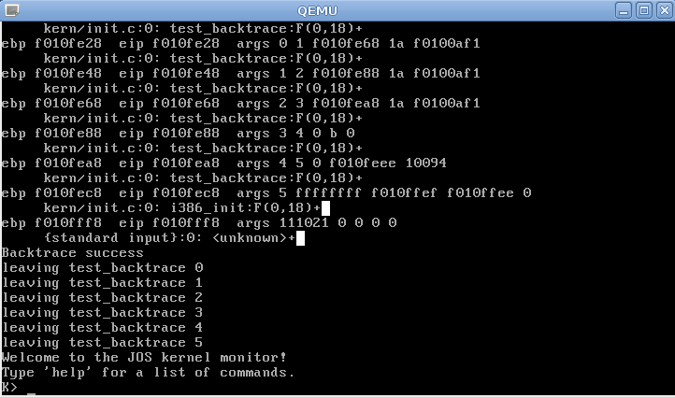
Lab 1 Boot a PC
Familiar with PC boot process

Slide 81
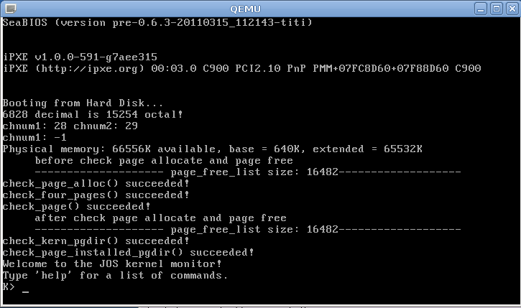
Lab2 Memory Management
Setup virtual memory map for JOS

Slide 82
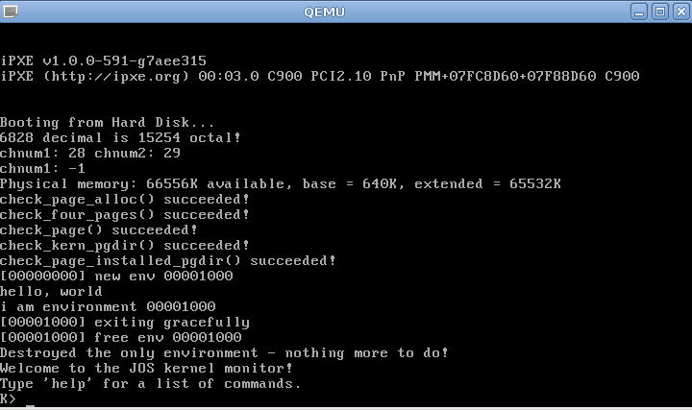
Lab3: User environment
Environment in JOS = Process in Linux
In this lab, only an environment on a single core

Slide 83
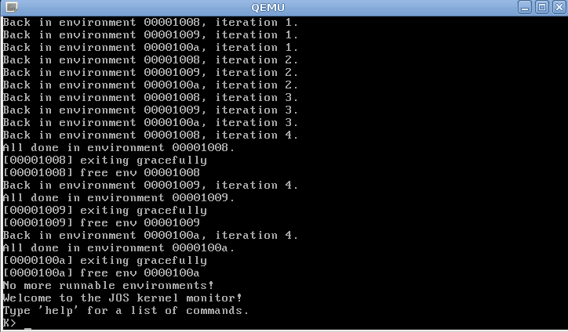
Lab4: Preemptive Multitasking
Multicore
Preemptive multitasking

Slide 84
Build your OS
Supporting code will be provided
Still a hard but interesting job
Hints: Start to work early and work hard

Slide 85
Lab Rules
Individual project
Don’t copy any code from others
Can read but don’t copy other OSes (Linux, Open/FreeBSD, etc.)
Cite any code that inspired your code
Please don’t post any “攻略”or code

Slide 86
Grading
General (Tentative)
Lab 1~4: 40%
Final Exam：40%
Labs will be reflected in exam
Homework: 10%
Help you to understand OS/Labs
Course performance (5%)
Q&A in classroom, Presentation
Bonus (5%): Lab5 & Lab6
Must finish both in order to get at least 80% scores
Notes:
86
01/03/2018

Slide 87
Homework
Writing your answer (you can use Chinese) to following questions
What is do_brk()? How to exploit?
http://www.csee.umbc.edu/courses/undergraduate/421/Spring12/02/slides/ULKV.pdf
Give your own explanation
Please send your answer to

Slide 88
Next Class
Introduction to PC programming
Booting of an OS

